Slide 1
Domain Squatting Attack: Antifa.com Pointing to JoeBiden.com
Peter Foytik

Slide 2
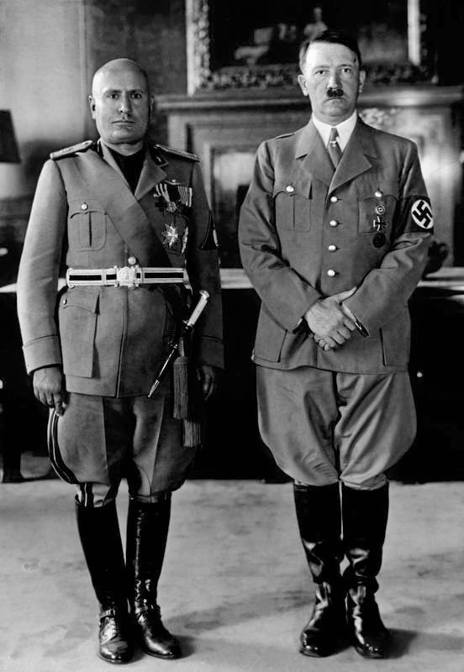
Fascism Definition
Merriam Webster:
A political Philosophy, movement or regime that,
exalts nation and often race above individual and,
stands for a centralized autocratic government headed by a dictatorial leader,
severe economic and social regimentation,
and forcible suppression of opposition
Most notable examples are pictured:
Fascist Italy lead by Benito Mussolini
Nazi Germany lead by Adolf Hitler
https://www.merriam-webster.com/dictionary/fascism
https://en.wikipedia.org/wiki/Fascism
By Unidentified photographer - http://img.audiovis.nac.gov.pl/PIC/PIC_2-12512.jpg, Public Domain, https://commons.wikimedia.org/w/index.php?curid=41283482

Slide 3
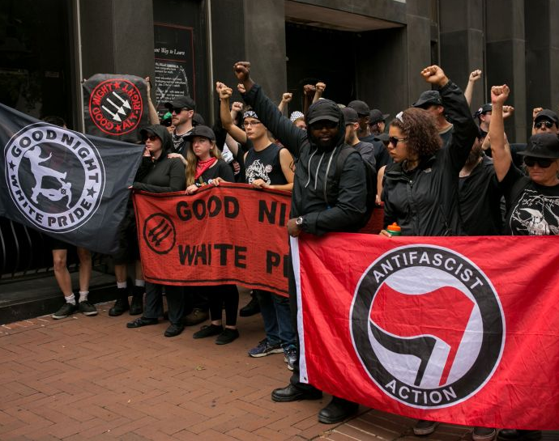
Antifascist Movement (Antifa)
https://www.theweek.in/news/world/2020/06/02/what-is-antifa-the-left-group-trump-terrorists-history-anti-fascist-mussolini.html
Idealogical movement against fascist government, capitalism

Slide 4
Political parties and their perspective to Antifa
Leaders in the major political parties have denounced the group
2017, Nancy Pelosi as house minority leader for Democratic party
https://web.archive.org/web/20170829224007/http://www.democraticleader.gov/newsroom/82917/
Various Republican senators have attempted to classify Antifa as a terrorist organization
https://web.archive.org/web/20201109182524/https://www.washingtonpost.com/politics/2019/07/20/senators-want-antifa-activists-be-labeled-domestic-terrorists-heres-what-that-means/
2020 Democratic party presidential elect Joe Biden also condemned Antifa violent actions:
https://web.archive.org/web/20200912100728if_/https://www.washingtonpost.com/outlook/five-myths/five-myths-about-antifa/2020/09/11/527071ac-f37b-11ea-bc45-e5d48ab44b9f_story.html

Slide 5
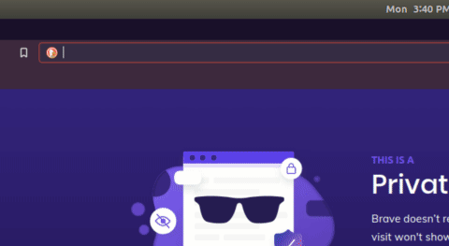
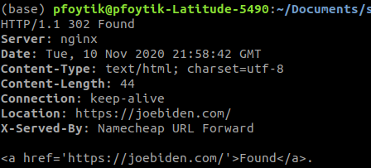
Antifa.com domain and Biden campaign website
Today if you go to antifa.com
Domain redirects the user To joebiden.com
August 2019
July 2020
August 12, 2020
January 2020
August 31, 2020
September 2020
Today
July 22, 2020
May 30, 2020
April 2002
September 2017
April 2020

Slide 6
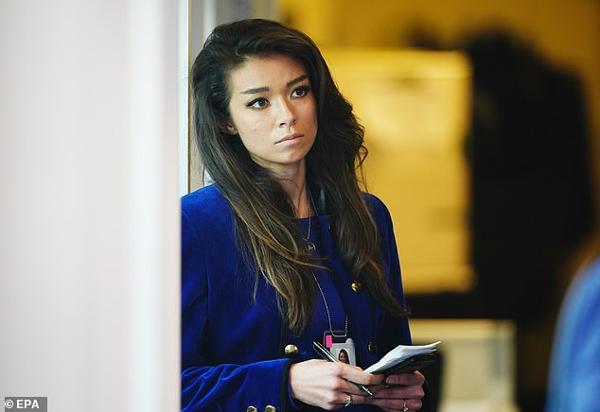
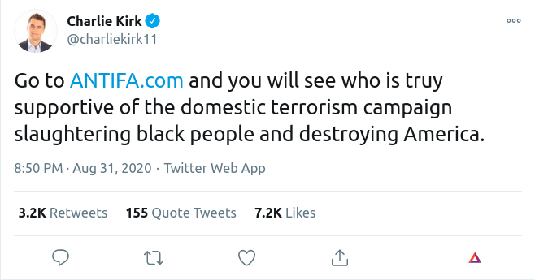
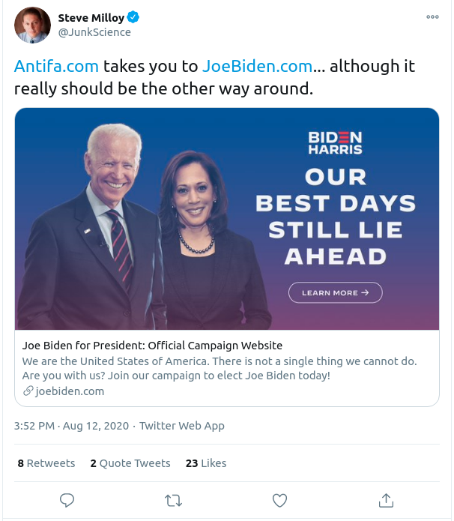
Public reactions to Antifa and Biden
Chanel Rion reporter with far-right network One America News asked Trump about Antifa pointing to Biden
https://www.dailymail.co.uk/news/article-8181867/Fake-conman-dad-questionable-resume-Truth-Chanel-Rion-Trumps-favorite-reporter.html
URI-R:
https://twitter.com/charliekirk11/status/1300596885774712832
URI-R:
https://twitter.com/JunkScience/status/1293636430800064514
August 2019
July 2020
August 12, 2020
January 2020
August 31, 2020
September 2020
Today
July 22, 2020
May 30, 2020
April 2002
September 2017
April 2020

Slide 7
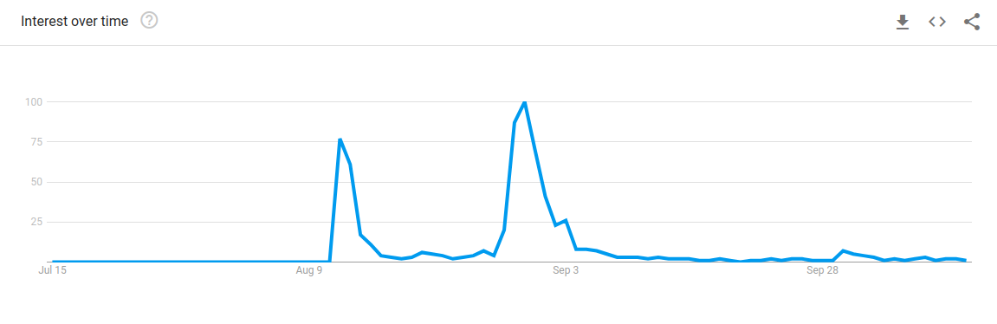
Google Trends for antifa.com from July 1 to October 15, 2020
https://trends.google.com/trends/explore?date=2020-07-01%202020-10-15&geo=US&q=antifa.com
August 2019
July 2020
August 12, 2020
January 2020
August 31, 2020
September 2020
Today
July 22, 2020
May 30, 2020
April 2002
September 2017
April 2020

Slide 8
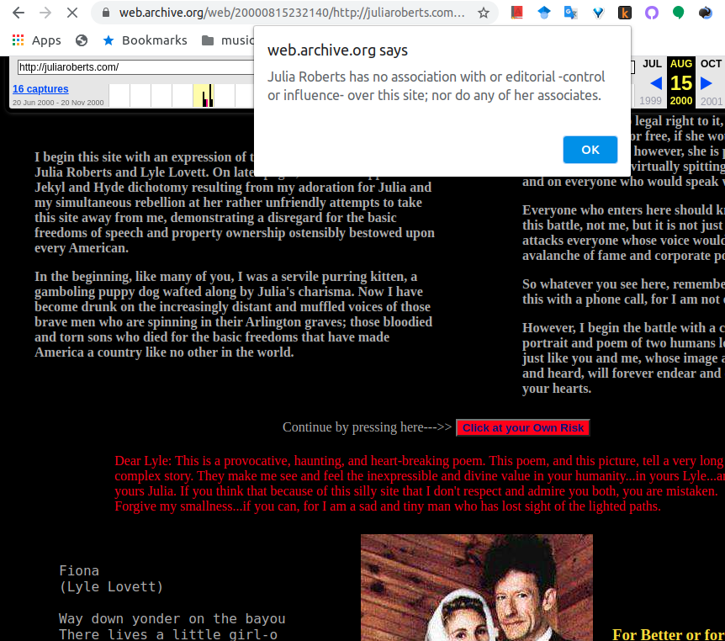
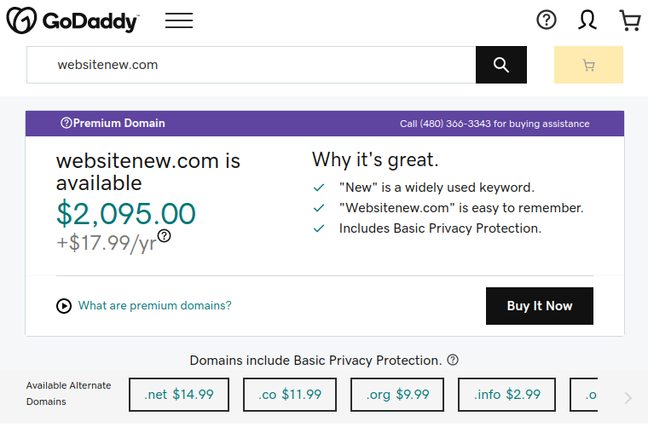
Cyber/Domain squatting definition and examples it all comes down to intent
Web.archive.org/web/20000815232140/http://juliaroberts.com

Slide 9
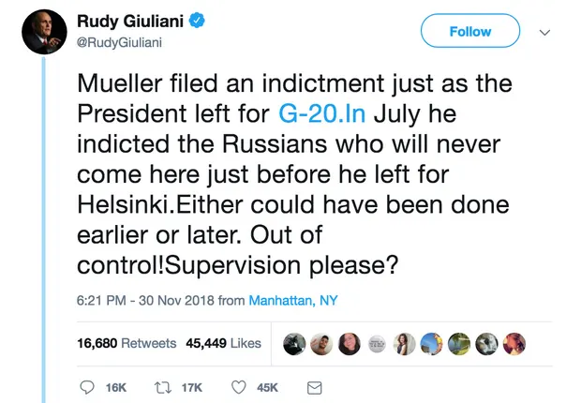
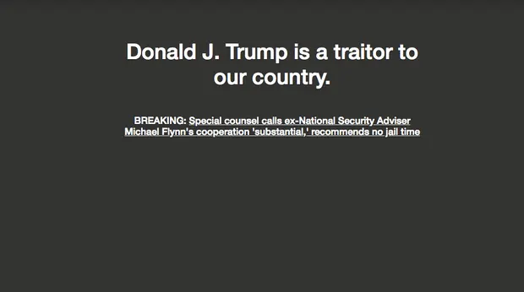
Political domain attacks from typos and/or false flag attacks
G-20.In website
https://www.theguardian.com/us-news/2018/dec/05/rudy-giuliani-helps-create-anti-trump-protest-website-with-twitter-typo

Slide 10
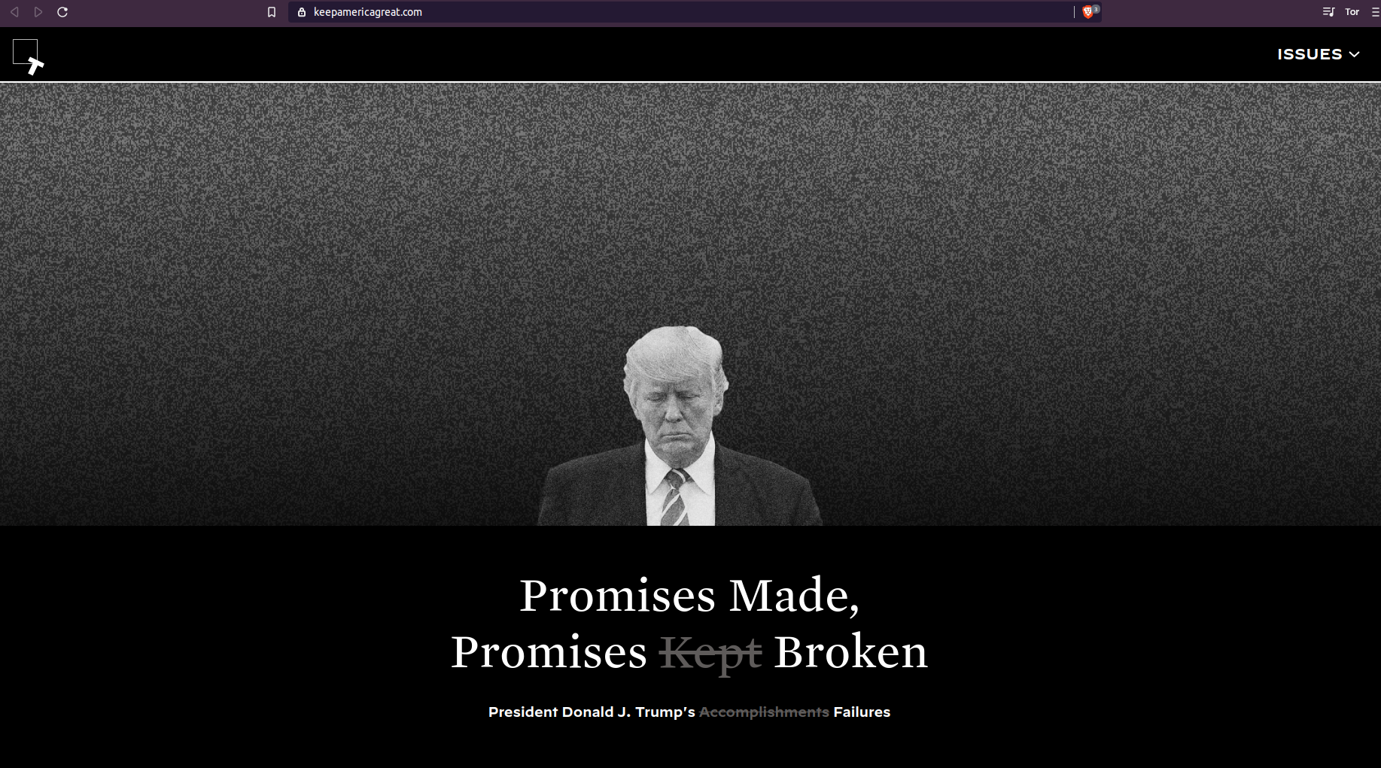
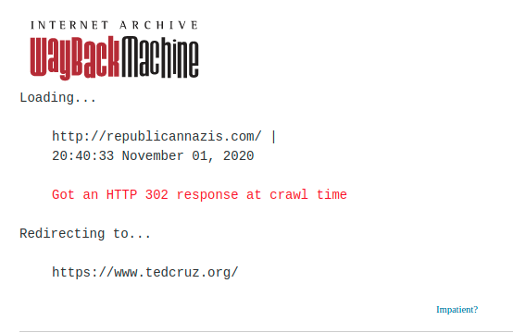
Additional examples of domain attacks/squatting
Keepamericagreat.com
Republicannazis.com redirects to tedcruz.com
URI-M:
https://web.archive.org/web/20201108114017/https://keepamericagreat.com/
URI-M:
https://web.archive.org/web/20201101204033/http://republicannazis.com/

Slide 11
Questions
Is Joe Biden's campaign a victim of potential domain attack/squatting?
Can we identify a sequence of events to show sources and/or actors of the attack?

Slide 12
Tools used to understand the context and effect of Antifa.com redirect
Memgator
Web Archives
Wayback Machine
Archive.is
Whois/Whoisology
Twitter
Twint
Google Trends

Slide 13
Today on the timeline
Today antifa.com still points to joebiden.com
No announcement of who is responsible for redirecting domain
Use Wayback machine observe any prior version of the website antifa.com
August 2019
July 2020
August 12, 2020
January 2020
August 31, 2020
September 2020
Today
July 22, 2020
May 30, 2020
April 2002
September 2017
April 2020

Slide 14
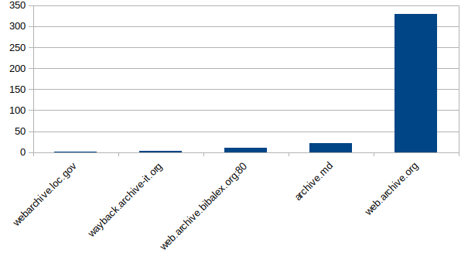
Mementos by archive from Memgator

Slide 15
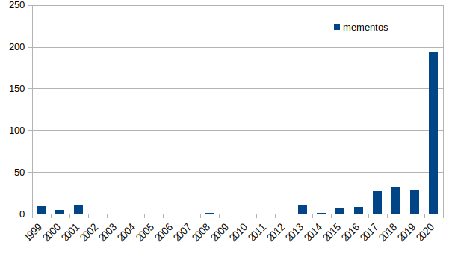
Timemap information from Memgator for antifa.com
August 2019
July 2020
August 12, 2020
January 2020
August 31, 2020
September 2020
Today
July 22, 2020
May 30, 2020
April 2002
September 2017
April 2020

Slide 16
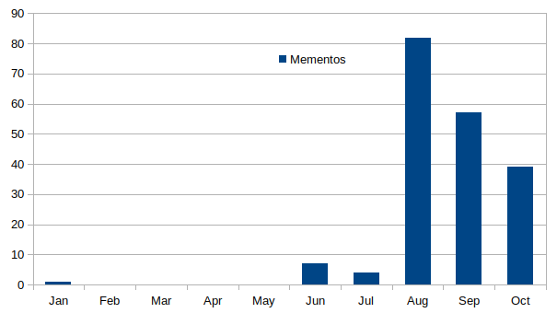
Mementos for 2020 by month
August 2019
July 2020
August 12, 2020
January 2020
August 31, 2020
September 2020
Today
July 22, 2020
May 30, 2020
April 2002
September 2017
April 2020

Slide 17
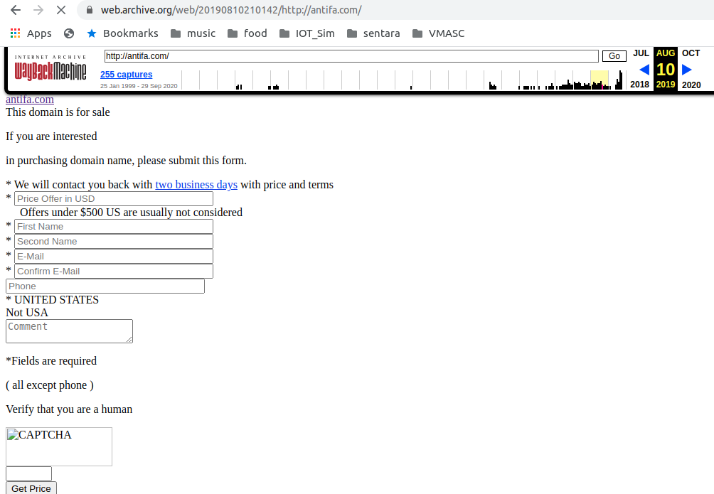
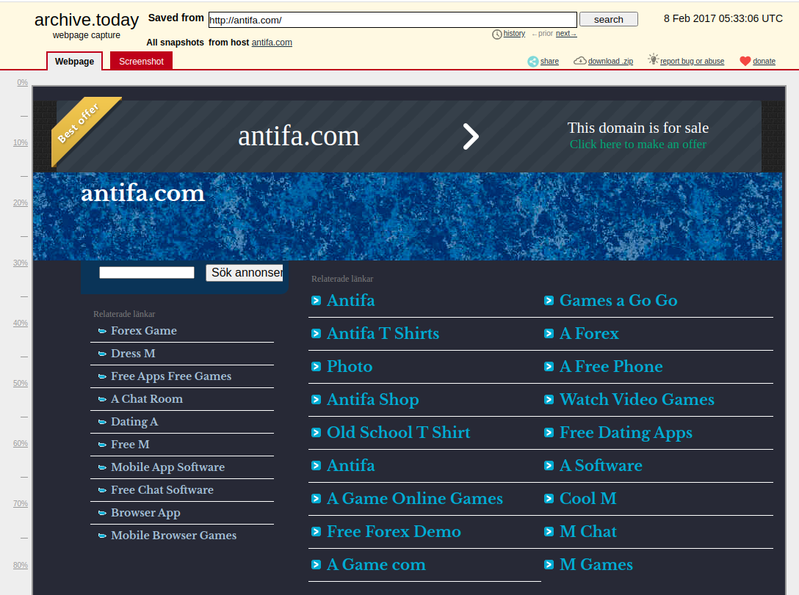
Archived history of antifa.com for sale
https://web.archive.org/web/20190810210142/http://antifa.com/
http://archive.today/2017.02.08-053306/http://antifa.com/
August 2019
July 2020
August 12, 2020
January 2020
August 31, 2020
September 2020
Today
July 22, 2020
May 30, 2020
April 2002
September 2017
April 2020

Slide 18
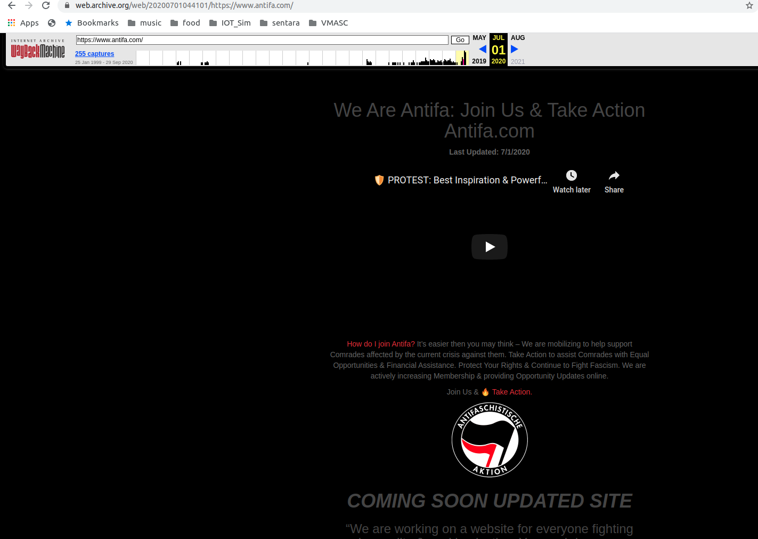
Archived history of antifa.com as website earliest archived record is May 30, 2020
https://web.archive.org/web/20200701044101/https://www.antifa.com/
August 2019
July 2020
August 12, 2020
January 2020
August 31, 2020
September 2020
Today
July 22, 2020
May 30, 2020
April 2002
September 2017
April 2020

Slide 19
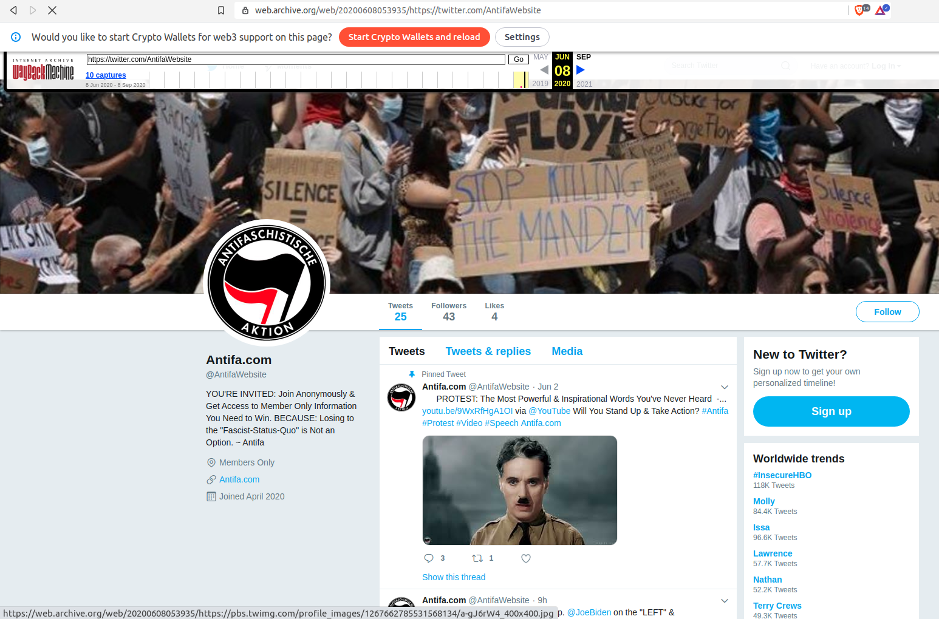
Associated Twitter account @AntifaWebsite Joined April 2020 (Twitter Removed) Earliest reply May 31, 2020
http://web.archive.org/web/20200608053935/https://twitter.com/antifawebsite
August 2019
July 2020
August 12, 2020
January 2020
August 31, 2020
September 2020
Today
July 22, 2020
May 30, 2020
April 2002
September 2017
April 2020
Notes:
Site links mostly pointed to the main page, a few pointed to a twitter account.

Slide 20

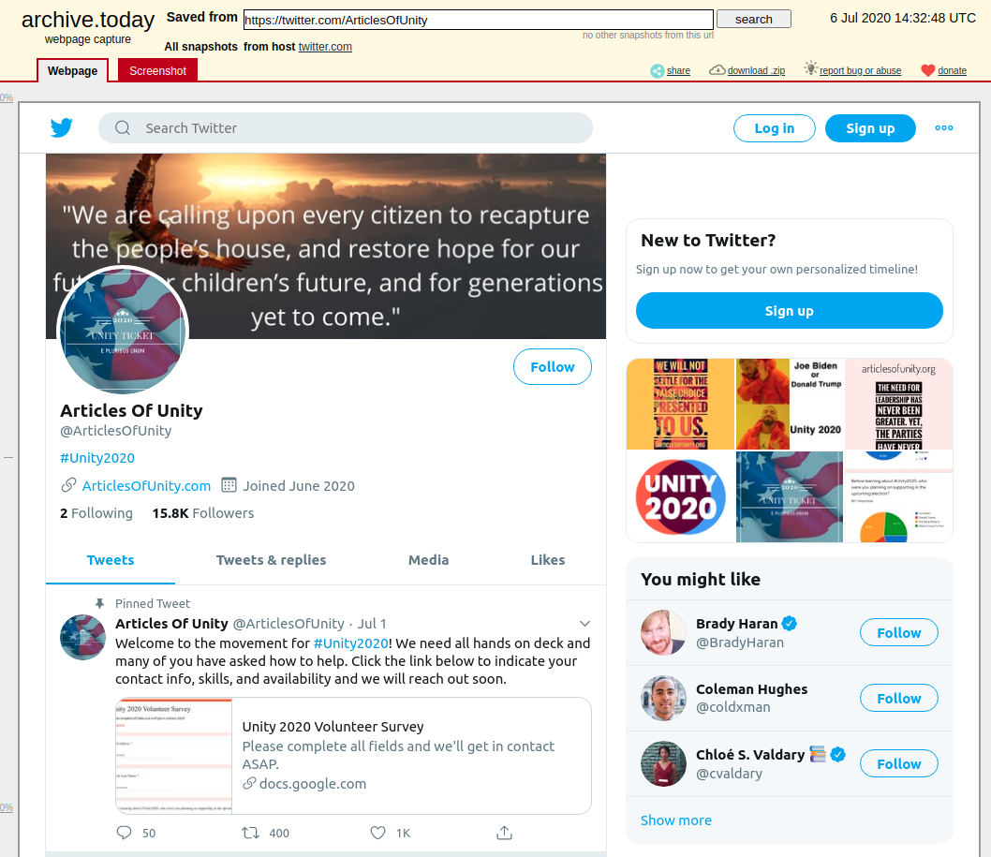
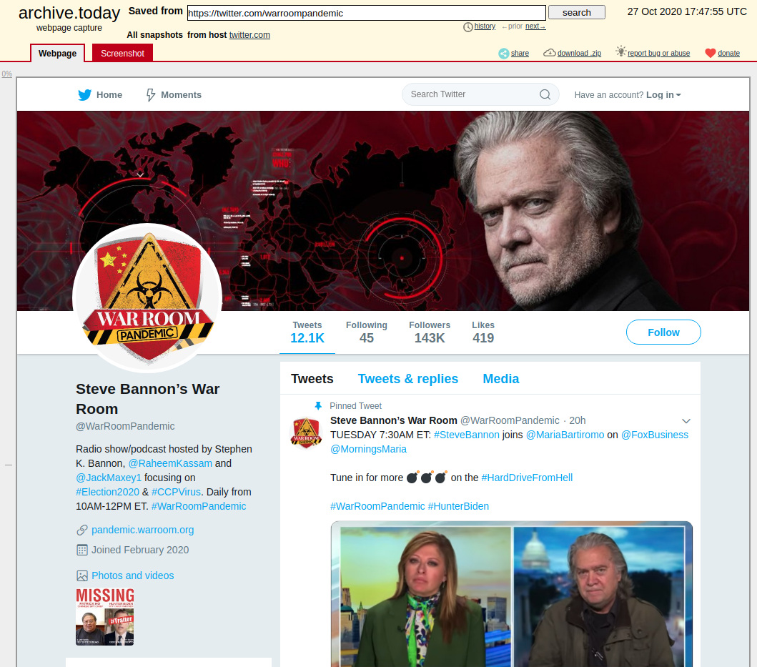
Twitter account terminations for violations of user agreement
https://en.wikipedia.org/wiki/Twitter_suspensions
Unity 2020 @ArticlesofUnity
Steve Bannon @WarRoomPandemic
http://archive.today/2020.08.17-153029/https://twitter.com/articlesofunity
http://archive.today/2020.10.27-174755/https://twitter.com/warroompandemic

Slide 21
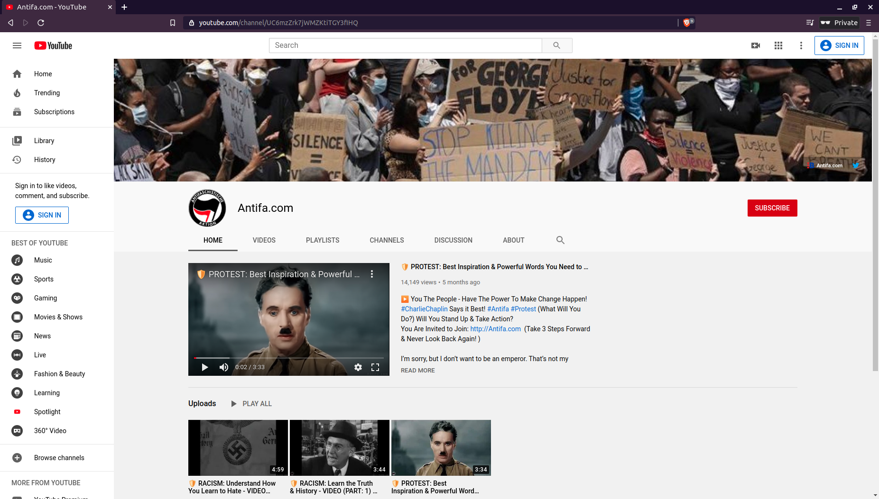
Associated Youtube account joined April 17, 2020 (Still Active)
https://www.youtube.com/channel/UC6mzZrk7jWMZKtiTGY3fIHQ
August 2019
July 2020
August 12, 2020
January 2020
August 31, 2020
September 2020
Today
July 22, 2020
May 30, 2020
April 2002
September 2017
April 2020
Notes:
The twitter account linked toi a youtube video which was associated with the antifa.com youtube channel.

Slide 22
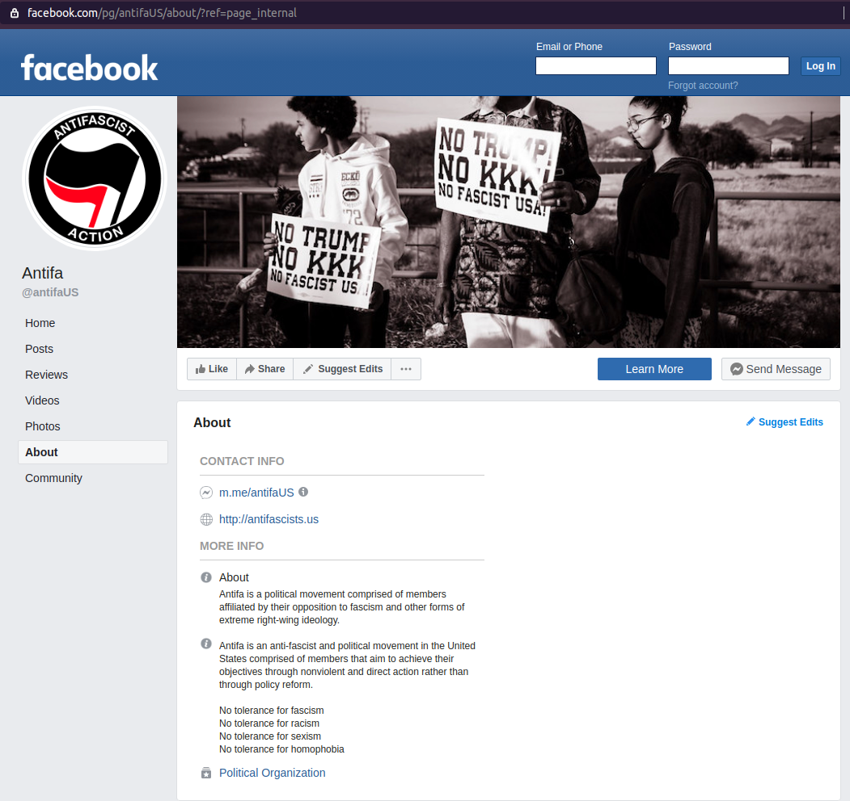
AntifaUS Facebook page does not appear to be associated with antifa.com
Started in September 2020
Points to a different live website
Antifascist.us
No records in Wayback
August 2019
July 2020
August 12, 2020
January 2020
August 31, 2020
September 2020
Today
July 22, 2020
May 30, 2020
April 2002
September 2017
April 2020
Notes:
Checked Facebook to see if there was a similar account

Slide 23
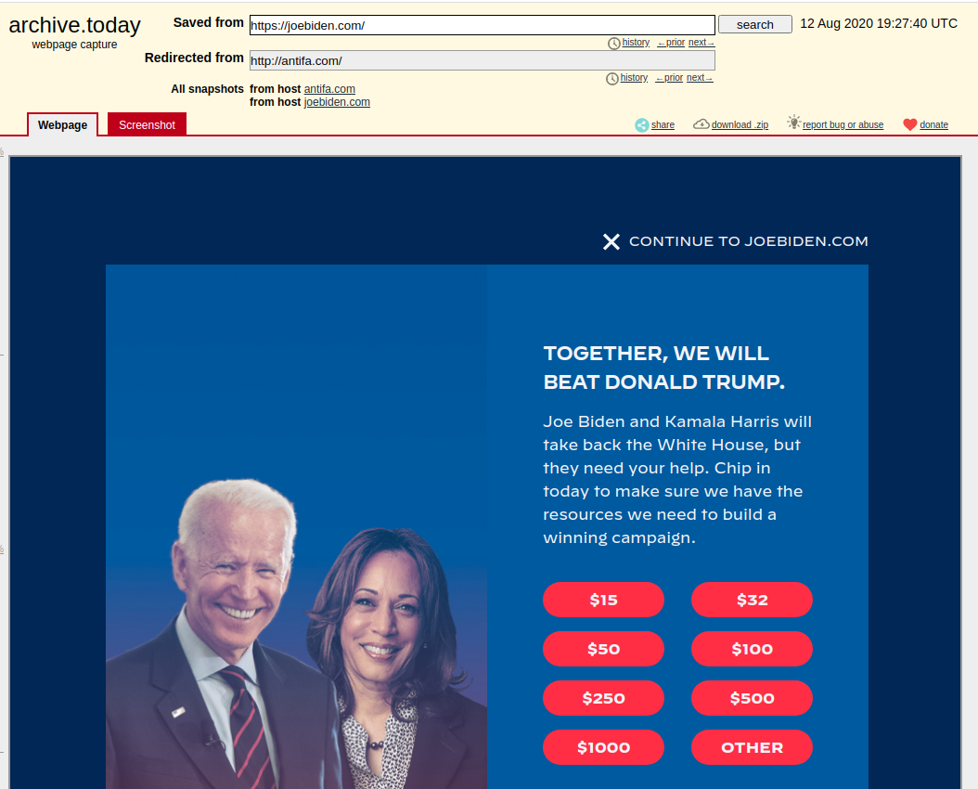
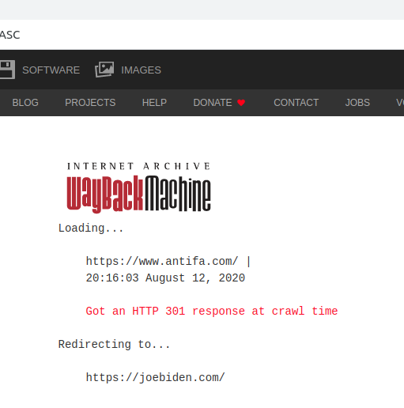
Archives showing the redirect to JoeBiden.com August 12, 2020
http://web.archive.org/web/20200812201603/http://antifa.com/
August 2019
July 2020
August 12, 2020
January 2020
August 31, 2020
September 2020
Today
July 22, 2020
May 30, 2020
April 2002
September 2017
April 2020
Notes:
So when did the antifa site go adown and the domain redirected to JoeBiden.com?

Slide 24
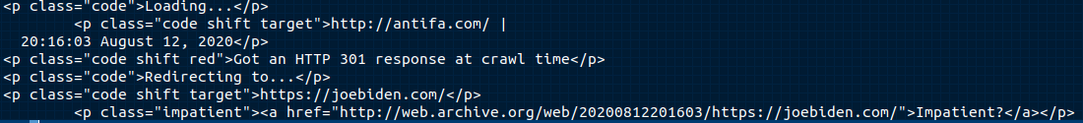
Web.archive http response to antifa.com shows 301 response and redirect to joebiden.com
August 2019
July 2020
August 12, 2020
January 2020
August 31, 2020
September 2020
Today
July 22, 2020
May 30, 2020
April 2002
September 2017
April 2020

Slide 25
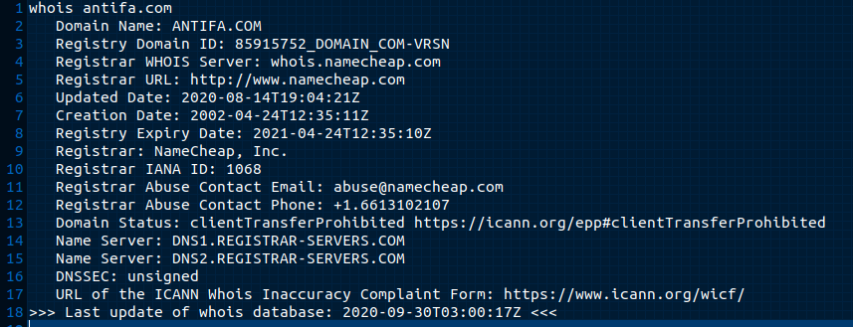
WhoIS results don't provide much
August 2019
July 2020
August 12, 2020
January 2020
August 31, 2020
September 2020
Today
July 22, 2020
May 30, 2020
April 2002
September 2017
April 2020
Notes:
Domain registration

Slide 26
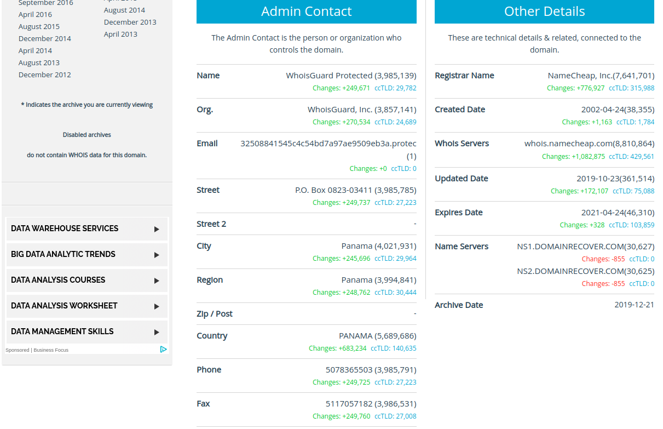
Whoisology provides a little more!
https://whoisology.com/antifa.com
August 2019
July 2020
August 12, 2020
January 2020
August 31, 2020
September 2020
Today
July 22, 2020
May 30, 2020
April 2002
September 2017
April 2020
Notes:
Whoisology archives domain registration information

Slide 27
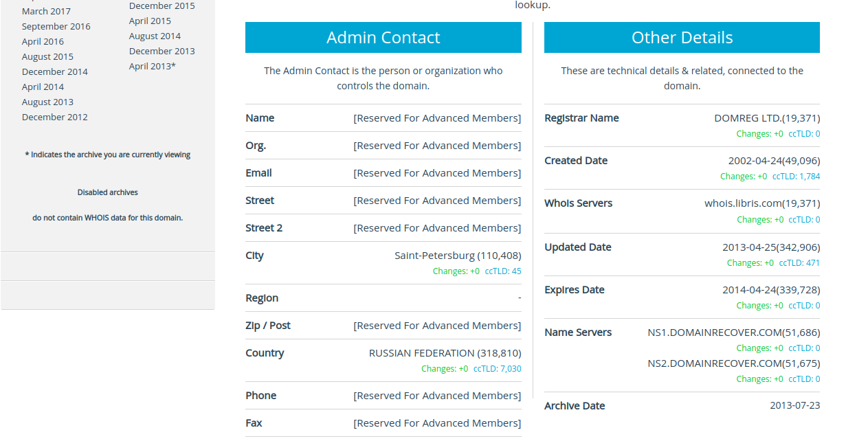
Whoisology prior to 2019 record
https://whoisology.com/archive_21/antifa.com
August 2019
July 2020
August 12, 2020
January 2020
August 31, 2020
September 2020
Today
July 22, 2020
May 30, 2020
April 2002
September 2017
April 2020

Slide 28
Twitter user response to antifa.com
Can we identify accounts that promoted antifa.com early based on dates of the Youtube account and website purchase?
Are these accounts bot like or human like?
What kind of influence were they able to achieve?
The following Twitter analysis is retrieved with twitter tool Twint
All tweets containing antifa.com were obtained
Analysis is done with verified users and unverified Twitter accounts
twint –s antifa.com --verified

Slide 29
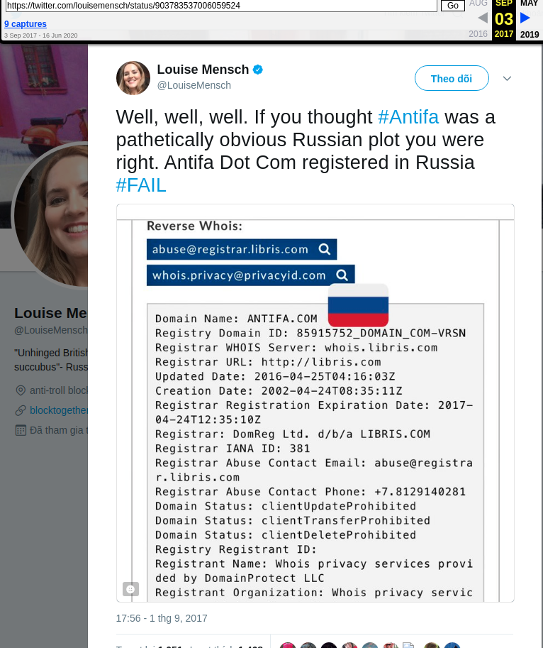
Earliest verified tweet containing antifa.com (now removed) Sep 03, 2017
Louise Mensch
British conservative tweeted that Russians have bought the domain
URI-M
http://web.archive.org/web/20170903231623if_/https://twitter.com/louisemensch/status/903783537006059524

Slide 30
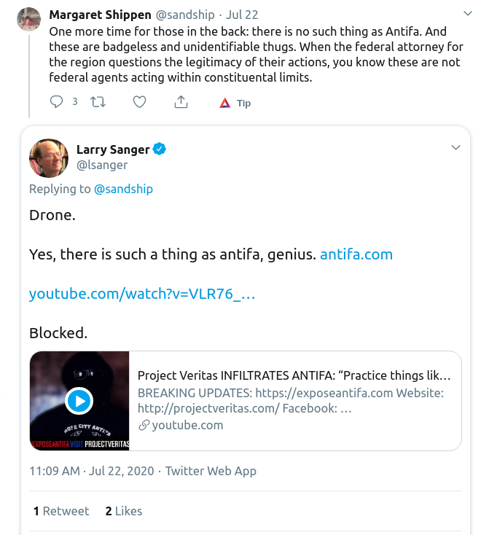
Earliest verified tweet referring antifa.com to the movement July 22, 2020
Larry Sanger
Co-founder of Wikipedia
URI-M:
http://web.archive.org/web/20200722234254/https://twitter.com/lsanger/status/1285955088259915776
URI-R:
https://twitter.com/lsanger/status/1285955088259915776

Slide 31
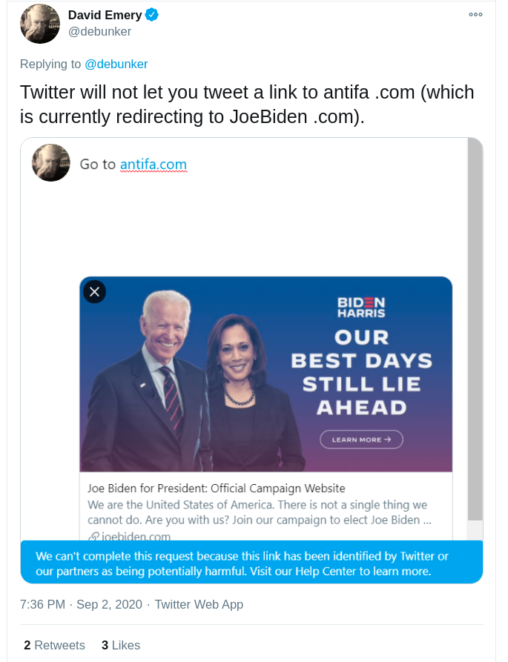
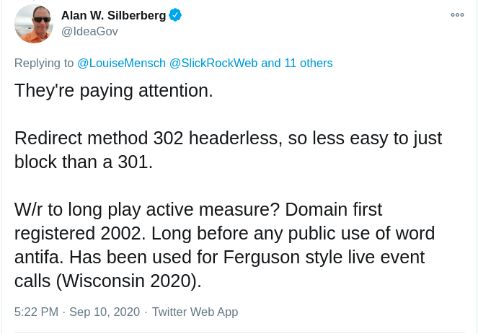
Ranking by number of tweets involving antifa.com two accounts worked to raise awareness and debunk the redirected domain
https://twitter.com/IdeaGov/status/1304168326130618368
https://twitter.com/debunker/status/1301303086741217281

Slide 32
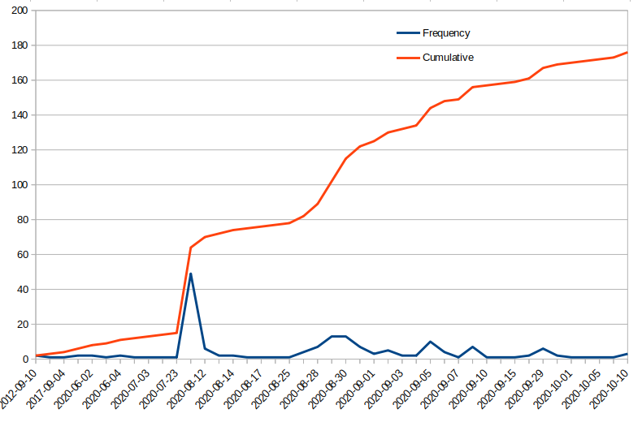


Twitter verified user tweets containing antifa.com
URI-R Larry Sanger:
https://twitter.com/lsanger/status/1285955088259915776
URI-R Charlie Kirk:
https://twitter.com/charliekirk11/status/1300596885774712832
August 2019
July 2020
August 12, 2020
January 2020
August 31, 2020
September 2020
Today
July 22, 2020
May 30, 2020
April 2002
September 2017
April 2020

Slide 33
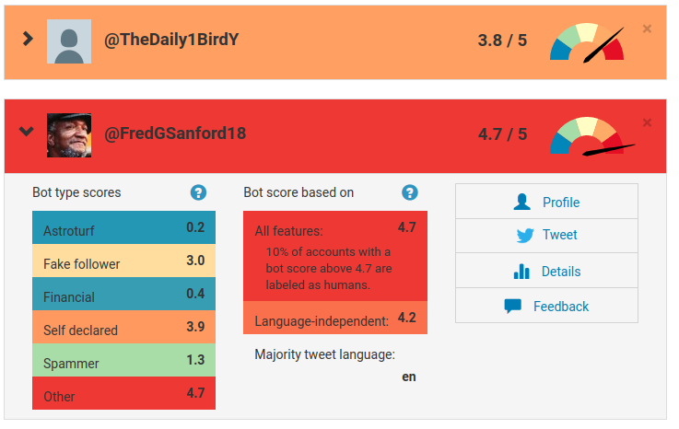
Unverified Twitter accounts top ten tweeters, 2 registered as bots from Botometer
Account | Tweets | Botometer
fredgsanford18 | 21 | 4.7
towlecarolyn | 13 | 1.8
li58653910 | 10 | 1.6
proud_vet1776 | 9 | 0.3
joetrela | 9 | 1
terrilfricke | 9 | 0
thedaily1birdy | 9 | 3.8
repealbagfee | 8 | 1
sebastian_usa | 8 | 0.4
susanwh68243181 | 7 | 1.4

Slide 34
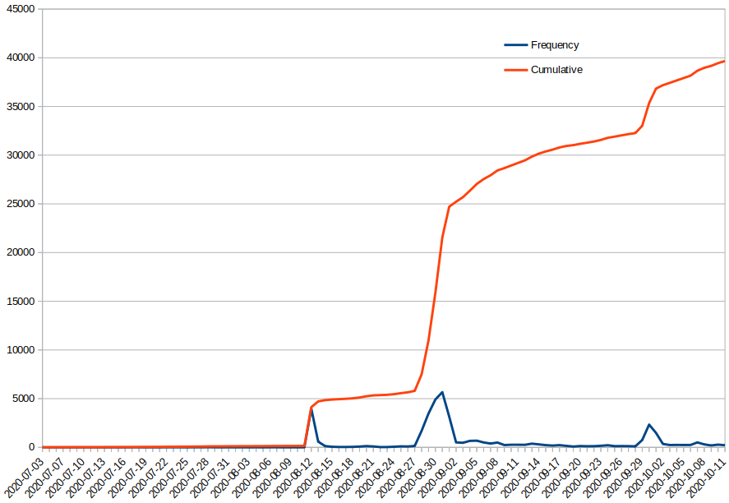
Twitter unverifed user tweets containing antifa.com
More Influencers Tweet
Tweets about Redirect
Bot Accounts Tweeting
Peaks match the google trends peaks*
August 2019
July 2020
August 12, 2020
January 2020
August 31, 2020
September 2020
Today
July 22, 2020
May 30, 2020
April 2002
September 2017
April 2020

Slide 35
Google Trends for antifa.com from July 1 to October 15, 2020
https://trends.google.com/trends/explore?date=2020-07-01%202020-10-15&geo=US&q=antifa.com
August 2019
July 2020
August 12, 2020
January 2020
August 31, 2020
September 2020
Today
July 22, 2020
May 30, 2020
April 2002
September 2017
April 2020

Slide 36
Final Thoughts
Was Joe Bidens campaign a victim of potential domain attack/squatting?
Evidence shows potential Russian involvement from purchase of the domain
No evidence of support from the political left
Can we identify events showing potential sources of the attack?
A lot of effort from the political right on the domain
Identified accounts that are potential bots contributing to the spread antifa.com
Just because a domain points to a website does not mean affiliation

